Slide 1


Stacks
Data Structures & Algorithms for Interviews
Vignesh Narayanan

Slide 2
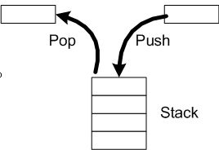
Stacks

Slide 3
Next Greater Element
Given an array, print the Next Greater Element (NGE) for every element. The Next greater Element for an element x is the first greater element on the right side of x in array. Elements for which no greater element exist, consider next greater element as -1.

Slide 4
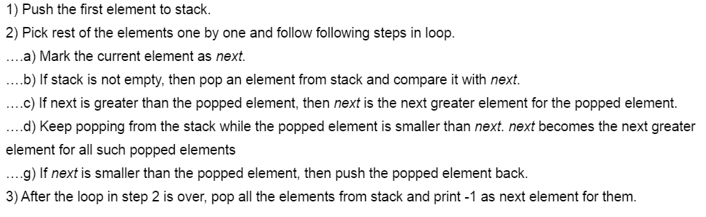

Slide 5
Implement Stack using Queues
We are given a Queue data structure that supports standard operations like enqueue() and dequeue(). We need to implement a Stack data structure using only instances of Queue.

Slide 6
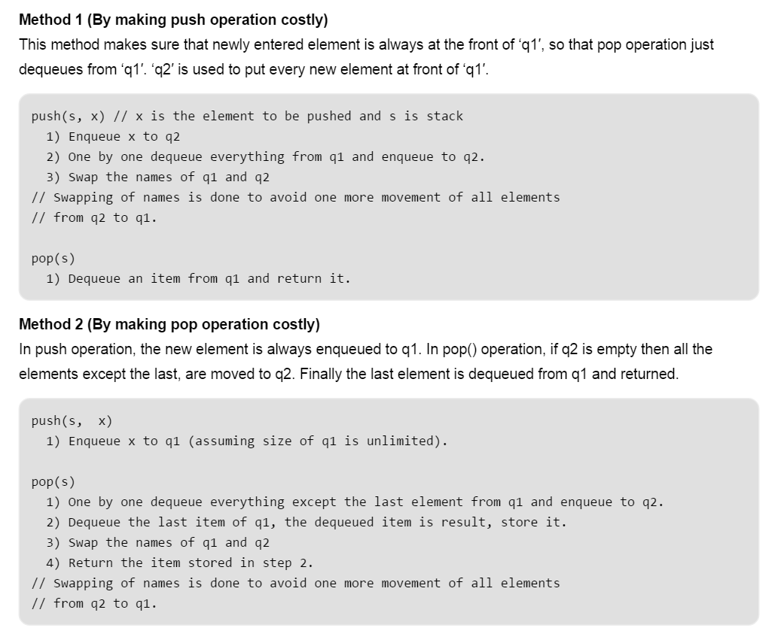

Slide 7
Design and Implement Special Stack Data Structure
Design a Data Structure SpecialStack that supports all the stack operations like push(), pop(), isEmpty(), isFull() and an additional operation getMin() which should return minimum element from the SpecialStack. All these operations of SpecialStack must be O(1).

Slide 8
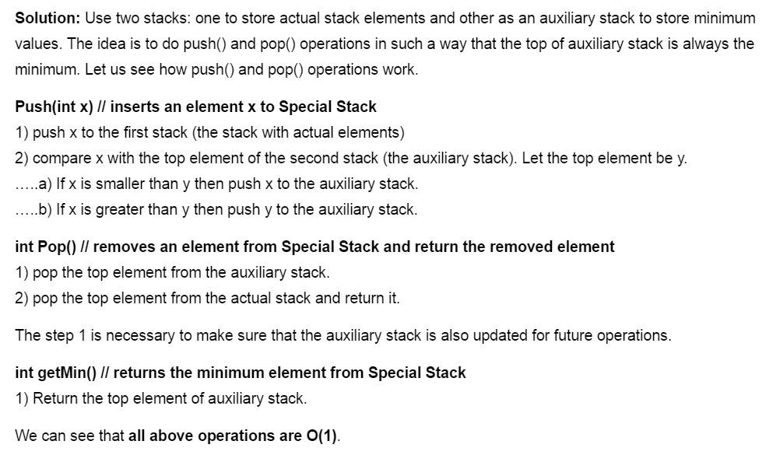

Slide 9
Similar Problem
Check for balanced parentheses in an expression: Given an expression string exp, write a program to examine whether the pairs and the orders of “{“,”}”,”(“,”)”,”[“,”]” are correct in exp.

